Slide 1
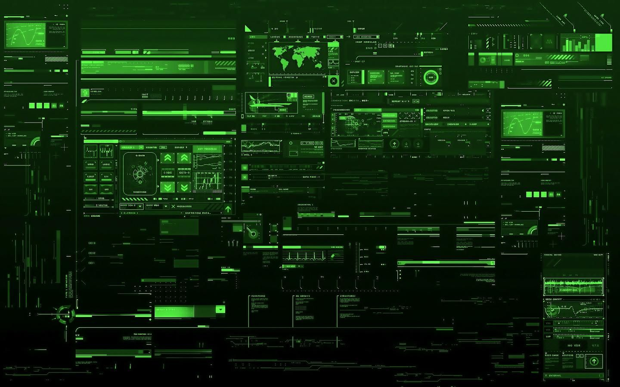
Final Engagement
Attack, Defense & Analysis of a Vulnerable Network

Slide 2
Table of Contents
This document contains the following resources:
01
Network Topology & Critical Vulnerabilities
02
Traffic Profile
03
Normal Activity
04
Malicious Activity

Slide 3
Network Topology
& Critical Vulnerabilities
01
‹#›

Slide 4
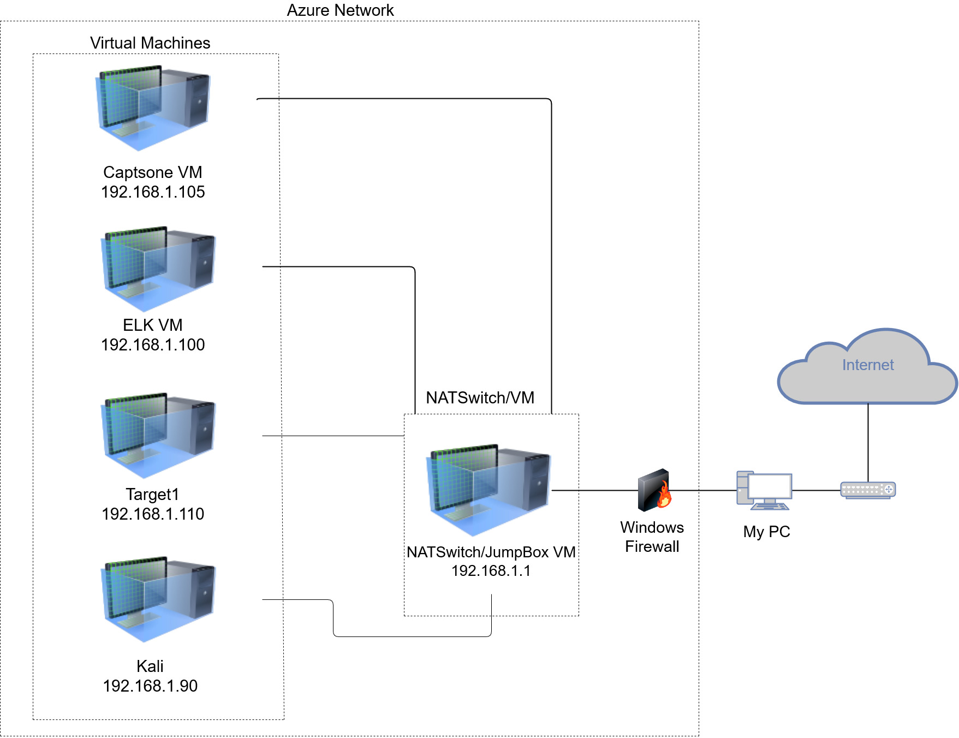
Network Topology
Network
Address Range: 192.168.1.0/24
Netmask: 255.255.255.0
Gateway: 192.168.1.1
Machines
IPv4: 192.168.1.105
OS: Linux
Hostname: Capstone
IPv4: 192.168.1.100
OS: Linux
Hostname: ELK Server
IPv4: 192.168.1.90
OS: Linux
Hostname: Kali
IPv4: 192.168.1.110
OS: Linux 3.2 - 4.9
Hostname: Target1

Slide 5
Critical Vulnerabilities: Target 1
Our assessment uncovered the following critical vulnerabilities in Target 1.
Vulnerability | Description | Impact
Brute Force Login | Cracked password due to insecure password protocols. | Hacked into Michael’s account.
User ssh Access | Established ssh connection as a regular user. | Remotely established a user shell.
Denial of Service | Service disruptions likely due to lack of protection measures. | Disruptions to server, network, and systems.
http POST Vulnerability | Unsecured http POST ability. | High attack exposure & strain on system resources.
Notes:
POST - http request smuggling, slow http POST attack,

Slide 6
Traffic Profile
02
‹#›

Slide 7
Traffic Profile
Our analysis identified the following characteristics of the traffic on the network:
Feature | Value | Description
Top Talkers (IP Addresses) | 172.16.4.205 & 185.243.115.84 | Machines that sent the most traffic.
Most Common Protocols | UDP - “DNS” TCP - “TLS” and “HTTP” Internet Group Management | Three most common protocols on the network.
# of Unique IP Addresses | 879 | Count of observed IP addresses.
Subnets | /24 or 256 | Observed subnet ranges.
# of Malware Species | 3 June11.dll Post.php PQ8twy | Number of malware binaries identified in traffic.
Notes:
Attachments with screenshots 1-7 provided separately.
/24 is 256 IP addresses
3 malware files discovered

Slide 8
Behavioral Analysis
Purpose of Traffic on the Network
Users were observed engaging in the following kinds of activity:
“Normal” Activity
Visiting chromebooktrivia.com
Browsing cardboardspaceshiptoys.com
Managing a Time Magazine subscription at subscription-assets-time.com
Researching how to flatten warped vinyl records at vinylmeplease.com
Suspicious Activity
Browsing and downloading movies from publicdomaintorrents.info
A user downloaded a trojan horse malware file called june11.dll
Browsing iphonehacks.com

Slide 9
Normal Activity
03
‹#›

Slide 10
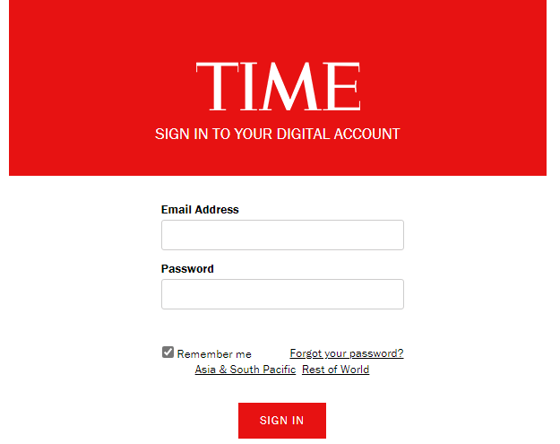

Normal Internet Browsing
Summarize the following:
HTTP traffic
The user was doing a GET Request; browsing the url below:
http://subscription-assets-time.com/prod/assets/themes/magazines/SUBS/templates/velocity/site/td.pcslogin/login.html

Slide 11
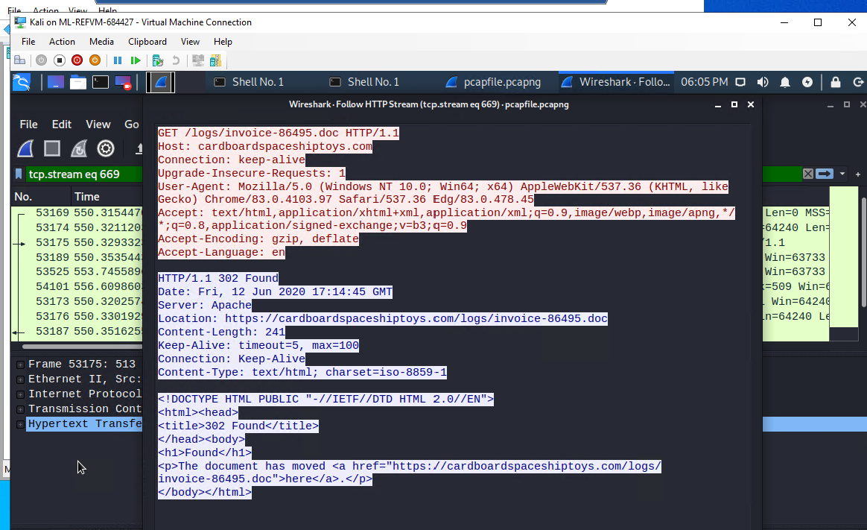
Typical Shopping Activity
Summarize the following:
What kind of traffic did you observe? Which protocol(s)? Traffic HTTP protocol TCP
What, specifically, was the user doing? Which site were they browsing? Get request cardboardspaceshiptoys.com
Include a description of any interesting files.

Slide 12
Malicious Activity
04
‹#›

Slide 13
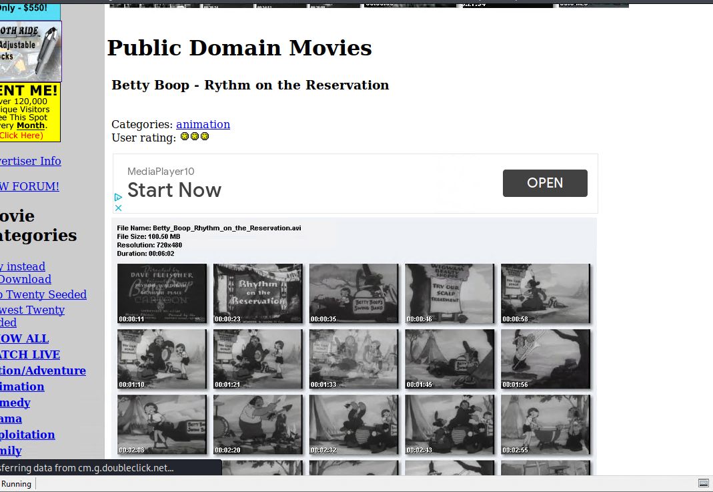
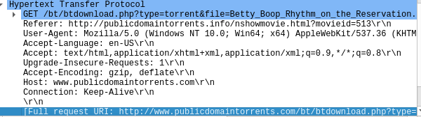
Downloading Torrented Movie
Summarize the following:
There was observed traffic using TCP, BitTorrent, and HTTP protocols.
The user on MAC address (00:16:17:18:66:c8), was browsing and downloading movies from the site: publicdomaintorrents.info
Below are screenshots of a packet showing the HTTP GET request for the movie file and another showing the webpage from which the files were downloaded.

Slide 14

Illicit Download
A Trojan Horse:
When observing HTTP packets it shows the download of a word document by the IP 10.6.12.157. Seven seconds later IP 10.6.12.203 navigates to 205.185.125.104.
The user navigates specifically to 205.185.125.104/files/june11.dll from no referring site.
The file that was downloaded is a Trojan Horse, which allows an unauthorized user remote access to the machine.

Slide 15
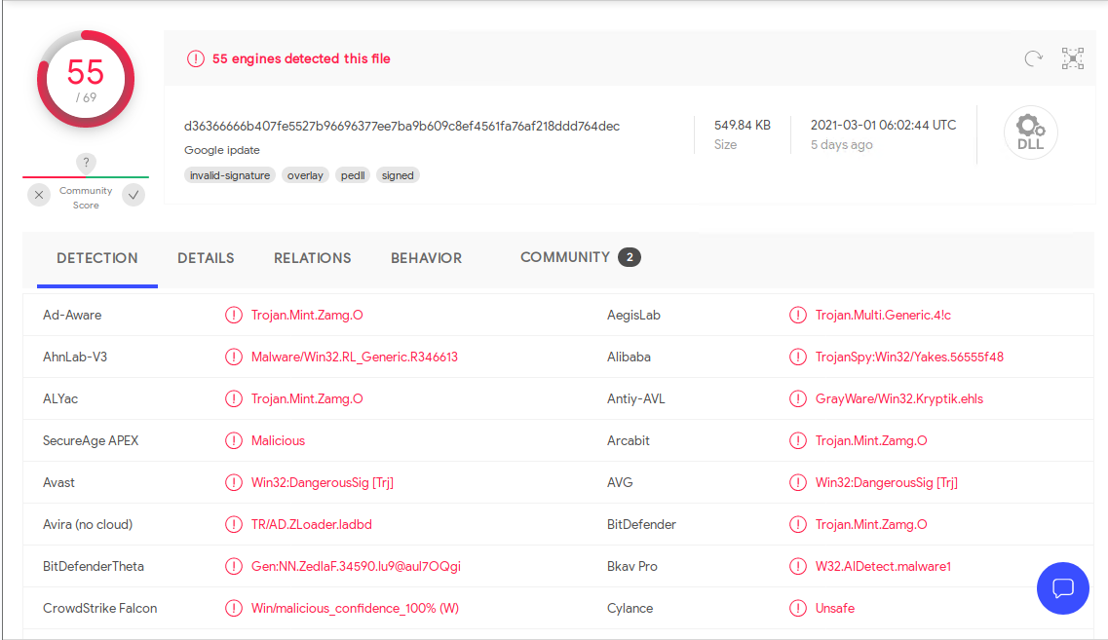
Illicit Download
A Trojan Horse:

Slide 16
The End
‹#›

